Slide 1
Competitive Analysis of Simply VMS, Vndly, and Indeed Flex
Competitor Analysis
Enohor Igbeyi

Slide 2
Introduction
Content: Overview of Simply VMS, Vndly, and Indeed Flex, focusing on factors such as User Interface, Experience, Artificial Intelligence, job posting volume, integrations, and pricing.

Slide 3


Overview of Simply VMS, Vndly, and Indeed Flex
Simply VMS
Simply VMS is a web-based Vendor Management System (VMS) designed to streamline all aspects of managing a contingent workforce. It offers features such as job order management, candidate review, workforce management, onboarding and compliance, client risk mitigation, and customizable reporting. The platform emphasizes ease of use, cost reduction, and enhanced communication between clients and staffing vendors.
Simple VMS
VNDLY
VNDLY, now part of Workday, is a cloud-native VMS that optimizes the end-to-end lifecycle of contingent labor and statement of work (SOW) management. It integrates seamlessly with Workday Human Capital Management (HCM) and other systems to support global compliance, efficiency, and agility. Key features include intuitive user interface, global digital invoicing, self-serve configurability, and robust integration capabilities.
Workday

Slide 4
Overview of Simply VMS, Vndly, and Indeed Flex
Features | Simply VMS | Vndly | Indeed Flex
Platform Type | Vendor Management System | Vendor Management System | Gig Economy Staffing Solution
Integration | Customizable integrations with existing systems | Seamless integration with Workday HCM and other systems | Integration with ATS and payroll systems
User Interface | User-friendly, web-based interface | Intuitive user interface with self-serve configurability | Real-time shift management and scheduling
Target Audience | Organizations seeking comprehensive vendor management | Enterprises requiring end-to-end contingent labor management | Businesses needing on-demand, flexible staffing solutions
Key Features | Job order management, candidate review, workforce management | Extended workforce management, SOW management, worker profile management | Real-time shift management, on-demand hiring, scheduling

Slide 5
Value Proposition Simply VMS, Vindly and Indeed Flex

Slide 6
Simply VMS Value Proposition
Simply VMS offers a user-friendly, web-based Vendor Management System (VMS) designed to streamline the management of contingent workforces. Its key value propositions include:
Cost-Effective Implementation: Simply VMS operates on a vendor-funded model, eliminating direct costs for clients. There are no charges for implementation, customization, integration, support, or timekeeping solutions, making it a budget-friendly option for organizations. Simple VMS
User-Friendly Interface: The platform is designed for ease of use, facilitating quick adoption without extensive training. Its intuitive interface allows clients to manage their contingent workforce efficiently, reducing administrative burdens. Simple VMS
Comprehensive Timekeeping Solutions: Simply VMS provides integrated timekeeping options, including web-based time entry, physical time clocks, system imports via open API, and telephonic time tracking. These tools ensure accurate time tracking for contingent workers. Simple VMS

Slide 7
Simply VMS Value Proposition
4. Customizable Reporting: The platform offers over 100 standard reports and allows users to tailor reports to meet specific organizational needs. This customization enables focused analysis on pertinent metrics, supporting informed decision-making. Simple VMS
5. Streamlined Billing Process: Simply VMS consolidates approved timesheets and expenses into a single invoice, simplifying the billing process for clients and enhancing financial oversight.

Slide 8
Vndly Value Proposition
VNDLY, now a part of Workday, offers a comprehensive vendor management system (VMS) designed to streamline and optimize the management of an organization's extended workforce, including contingent labor and outsourced services. Its key value propositions include:
Unified Workforce Management: VNDLY integrates seamlessly with Workday Human Capital Management (HCM), providing organizations with a holistic view of both full-time and contingent workers. This unified approach enables better planning, execution, and analysis of the total workforce, enhancing strategic decision-making. Workday Blog
Enhanced Visibility and Compliance: By consolidating data related to all worker types, VNDLY offers comprehensive insights into workforce composition, costs, and compliance. This visibility helps organizations manage risks associated with labor regulations and co-employment laws, ensuring adherence to local and global standards. Workday Blog

Slide 9
Vndly Value Proposition
3. Operational Efficiency: VNDLY automates and streamlines processes such as vendor collaboration, sourcing optimization, invoicing, and onboarding/offboarding of contingent workers. This automation reduces administrative burdens, accelerates time-to-hire, and improves overall operational efficiency. Workday
4. Scalability and Flexibility: As a cloud-native platform, VNDLY is designed to scale with organizational growth and adapt to changing workforce dynamics. Its configurable interface allows for quick adjustments to program management, accommodating evolving business needs. Workday Investor
5. Data-Driven Insights: VNDLY's robust reporting and analytics capabilities provide organizations with actionable insights into workforce trends, performance metrics, and financial data. These insights support informed decision-making and strategic workforce planning. Workday

Slide 10
Executive Summary Simply VMS, Vindly and Indeed Flex

Slide 11
Competitor Analysis Research Executive Summary
This "Competitive Analysis of Simply VMS, Vndly, and Indeed Flex"report offers an in-depth comparison of three Vendor Management Systems (VMS) focusing on their capabilities, value propositions, user experience, AI integration, and pricing models. Each platform is evaluated based on its target users, interface design, integration features, and suitability for different business needs.
Key Findings:
Simply VMS:
User-Friendly, Cost-Effective: Designed as a straightforward, budget-friendly solution with no direct cost to clients (vendor-funded).
Strong Customization & Reporting: Offers customizable dashboards, timekeeping solutions, and over 100 reporting options, ideal for clients prioritizing ease of use and cost savings.
Integration Flexibility: Easily integrates with Applicant Tracking Systems (ATS) and payroll systems.
Vndly (a Workday Company):
Enterprise-Grade, Cloud-Native: Built for large organizations with robust integration with Workday’s Human Capital Management system, providing a holistic view of the workforce.
Advanced AI Capabilities: Features predictive hiring and resource allocation using machine learning, supporting strategic workforce planning.
Scalable & Configurable: Adaptable for growing businesses with customizable dashboards that offer real-time analytics and predictive insights.

Slide 12
Competitor Analysis Research Executive Summary
3. Indeed Flex:
Gig Economy Focused: Tailored for high-turnover industries, focusing on short-term, shift-based roles with an accessible mobile app.
On-Demand Staffing: Emphasizes rapid shift matching using AI-driven talent matching for quick placements, ideal for retail and hospitality.
Transparent Pricing: Operates on an hourly markup without additional setup fees, providing a clear and straightforward pricing structure.
Good to know.
For Larger Enterprises: Vndly is recommended for its comprehensive, enterprise-level solutions, particularly for organisations needing deep integration with existing HR systems and robust analytics.
For Small to Medium Businesses Seeking Cost-Effective Options: Simply VMS provides a practical, user-friendly platform with low operational costs and essential reporting features.
For Fast-Paced, High-Turnover Industries: Indeed Flex’s agile staffing model and mobile-first approach make it ideal for sectors requiring immediate, flexible staffing.

Slide 13
What can Indeed Flex emulate to enhance its appeal by adapting the some positive selling points from Vndly and Simply VMS:
Enhanced Reporting and Customization (from Simply VMS and Vndly):
Detailed Reporting Features: Adopting Simply VMS's approach to customizable reporting with over 100 report types could provide Indeed Flex users with deeper insights into workforce metrics, labour costs, and performance data. Enhanced reporting can support better decision-making and workforce planning.
Predictive and Real-Time Analytics: Borrowing Vndly’s real-time analytics and predictive insights could add value for employers by helping anticipate staffing needs and optimising shift scheduling in advance.
Scalability and Enterprise Integration (from Vndly):
Seamless Integration with HR Systems: By aligning with popular HR systems like Workday or other major HCM platforms, Indeed Flex could support companies seeking a more unified workforce management experience, which is particularly valuable for larger clients.
Scalability for Growth: Vndly’s cloud-native, scalable design is a strong selling point for enterprises. Indeed Flex could benefit from promoting its adaptability to business expansion, helping it cater to both small businesses and large organisations as their needs grow.

Slide 14
What can Indeed Flex emulate to enhance its appeal by adapting the some positive selling points from Vndly and Simply VMS:
3. Transparency in Billing and Cost-Effectiveness (from Simply VMS):
Cost-Efficiency: Adapting Simply VMS’s vendor-funded, low-cost model or offering alternative cost structures could make Indeed Flex even more attractive to budget-conscious clients.
Streamlined Invoicing and Billing: Similar to Simply VMS’s consolidated billing process, implementing a simplified, customizable invoicing system could reduce administrative burdens and enhance financial oversight for Indeed Flex clients.
4. AI-Enhanced Workforce Planning and Matching (from Vndly):
AI for Predictive Hiring: Incorporating Vndly’s AI-driven predictive hiring capabilities would allow Indeed Flex to optimize shift allocation based on demand forecasts, ensuring companies have the right talent when needed.
Enhanced Talent Matching: Indeed Flex already focuses on AI-driven matching but could further leverage machine learning to recommend optimal shifts based on worker history and preferences, improving match quality and employee satisfaction.

Slide 15
What can Indeed Flex emulate to enhance its appeal by adapting the some positive selling points from Vndly and Simply VMS:
5. Improved User Interface and Customizable Dashboards (from Simply VMS and Vndly):
Customizable Dashboards: Providing dashboard customization options, as seen in both Vndly and Simply VMS, could allow managers to focus on key metrics, such as shift fulfillment rates or worker availability, enhancing the usability of Indeed Flex’s platform.
Real-Time Data Visualization: Vndly’s visually engaging, real-time dashboards could help Indeed Flex present shift metrics and workforce data in a more accessible format, aiding quick decision-making in high-turnover environments.

Slide 16
User Interface (UI) and User Experience (UX) Analysis Simply VMS, VNDLY, and Indeed Flex

Slide 17
User Interface (UI) and User Experience (UX) Analysis: Simply VMS, VNDLY, and Indeed Flex
For a simpler system, Simply VMS has a web-based interface where users can perform functions such as job listing, candidate management, and labor expenses.
Its design is driven by functionality, allowing users to log in and efficiently manage different aspects of the program using deep-dive dashboards.
Vndly has a visually contemporary UI dedicated to workforce observation and data incorporation with real-time boards that help users in strategic workforce planning.
IndeedFlex is targeted toward gig workers and managers and focuses on real-time status updates and quick shift bookings, which is useful for companies where turnover is high, such as retail or hospitality​.
(Simply VMS) | (Vndly) offer detailed and flexible dashboards to accommodate the extensive personnel management, different from IndeedFlex short-term recruitment tool with less complex interface.

Slide 18
Here is a breakdown of the differences in interface design and user experience among Simply VMS, VNDLY, and Indeed Flex, highlighting each platform’s unique approach:
Simply VMS
Focus on Functionality: Simply VMS is designed with a functional, streamlined approach that prioritizes ease of use for users managing vendor and contingent labor processes.
Key Features: Its UI is straightforward and focused on practical needs, including job order management, candidate review, onboarding, compliance tracking, and workforce reporting.
User Experience (UX): Simply VMS ensures users can perform essential tasks efficiently with minimal training, making it ideal for organizations that need a solution that “just works” without complex setups.
Visual Design: Rather than investing in heavy visual elements, Simply VMS opts for a minimalistic interface that keeps the focus on getting tasks done quickly, which is advantageous for users who value functionality over aesthetics.

Slide 19
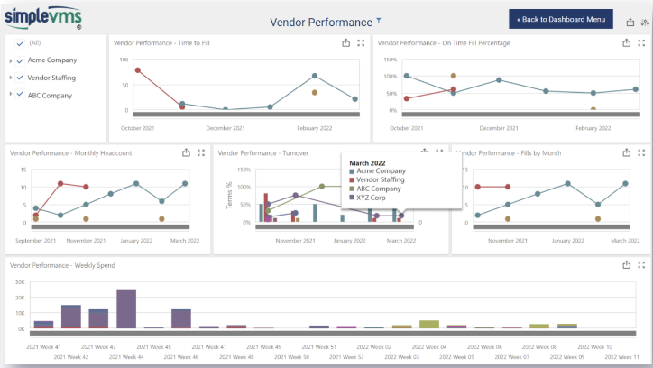
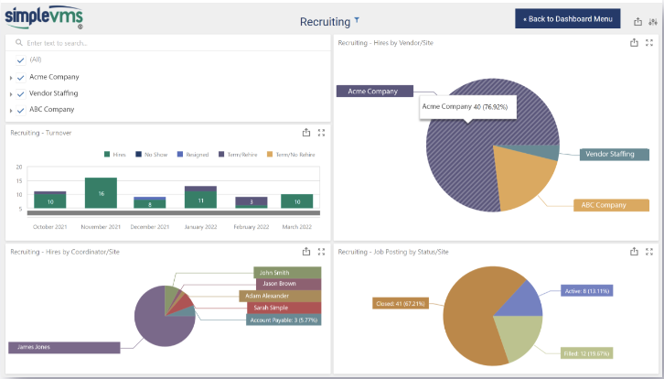
Simply VMS Design Interface

Slide 20
Here is a breakdown of the differences in interface design and user experience among Simply VMS, VNDLY, and Indeed Flex, highlighting each platform’s unique approach:
VNDLY
Modern and Visual UI: VNDLY offers a more visually sophisticated, modern interface that enhances the user experience with real-time dashboards, intuitive navigation, and data-driven visuals.
Key Features: The platform supports extended workforce and SOW (Statement of Work) management, enabling companies to manage a variety of contingent labor needs. Its UI incorporates features for monitoring worker profiles, digital invoicing, and budget tracking, aimed at enterprise clients.
User Experience (UX): VNDLY’s design is more engaging, with real-time data analytics and predictive insights that support strategic decision-making. The interface is particularly suitable for large enterprises looking for a more interactive and data-rich experience.
Visual Design: Emphasizes sleek, modern visuals, with a user-centric approach that leverages design to improve workforce planning and resource allocation, making the platform visually appealing while functional.

Slide 21
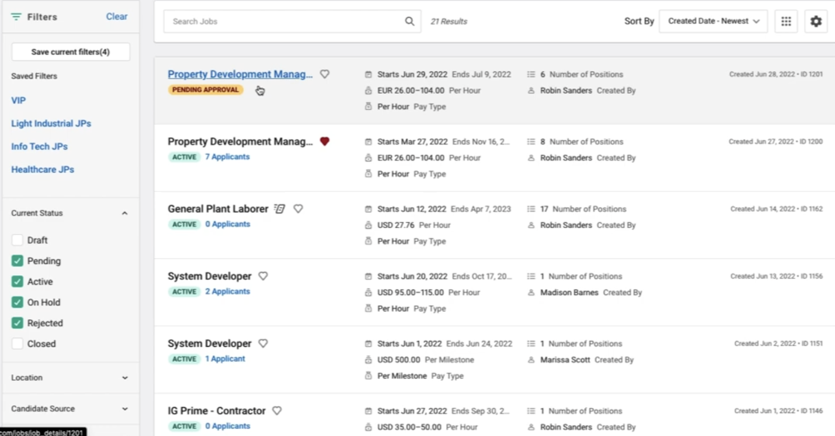
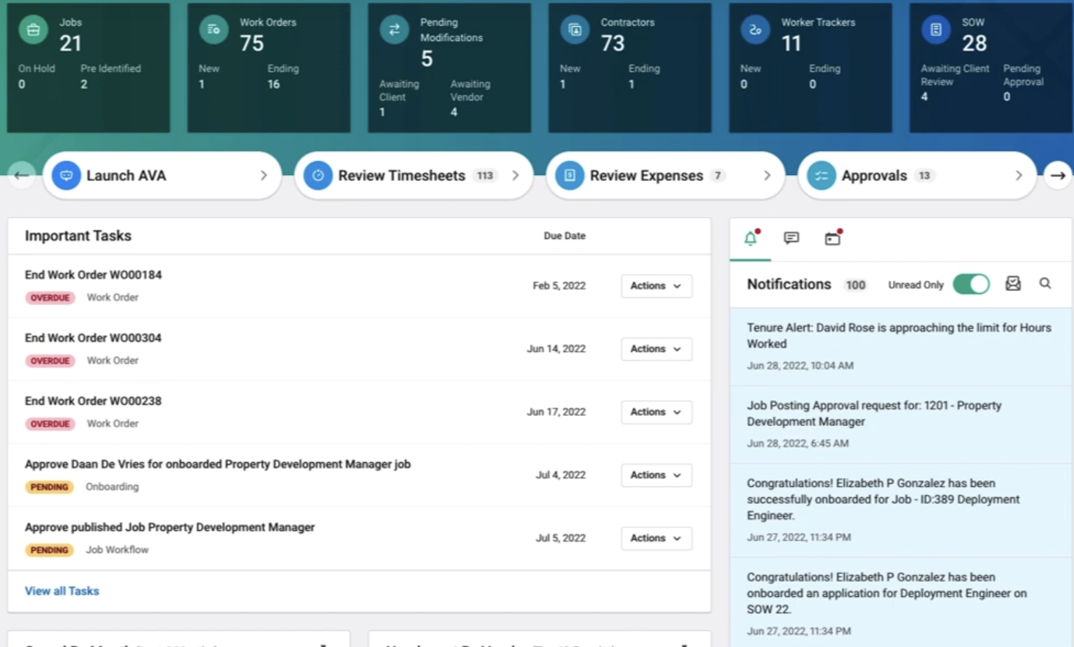
Vndly Design Interface

Slide 22
Here is a breakdown of the differences in interface design and user experience among Simply VMS, VNDLY, and Indeed Flex, highlighting each platform’s unique approach:
Indeed Flex
Real-Time Status Updates: Indeed Flex’s UI is built around the needs of the gig economy, where real-time updates, responsiveness, and mobile accessibility are crucial.
Key Features: Designed primarily for high-turnover industries (e.g., retail, hospitality), Indeed Flex allows managers to post shifts in real-time and workers to accept jobs immediately. The platform is optimized for fast-paced environments where staffing needs change frequently.
User Experience (UX): Focuses on speed and accessibility, allowing both employers and workers to handle job postings, shift assignments, and updates instantly. This mobile-first approach ensures usability across devices, which is critical for gig workers who are often on the move.
Visual Design: The interface is simple yet highly responsive, with real-time updates that keep both workers and managers informed about shift status and availability. Its visual design is less complex but very functional for short-term, flexible staffing.

Slide 23
AI Integration Simply VMS, VNDLY, and Indeed Flex

Slide 24
AI Intergation - Simply VMS, Vndly and IndeedFlex
Simply VMS is a web-based Vendor Management System (VMS) designed to streamline vendor management and workforce processes. While specific details about Simply VMS's AI integration are limited, the platform emphasizes functionality and efficiency in managing contingent workforces.
In contrast, VNDLY, now part of Workday, offers a cloud-native VMS that integrates AI-driven features to enhance contingent workforce management. VNDLY's platform includes predictive analytics and machine learning capabilities to optimize sourcing strategies, resource allocation, and compliance management. These AI features provide users with data-driven insights, improving decision-making and operational efficiency.
Workday Blog
Indeed Flex focuses on real-time shift management and on-demand worker hiring, catering to the gig economy. The platform utilizes AI to match shifts with worker profiles, ensuring optimal placement and efficiency. This AI-driven approach enables businesses to quickly fill shifts with suitable candidates, enhancing responsiveness to staffing needs.
In summary, while Simply VMS prioritizes streamlined functionality, competitors like VNDLY and Indeed Flex have integrated AI features to enhance predictive analytics, resource allocation, and real-time matching, offering more advanced capabilities in contingent workforce management.

Slide 25
VNDLY: Advanced AI Integration for Enterprise-Grade Workforce Management
Predictive Hiring: VNDLY, part of Workday, utilizes AI to offer predictive hiring capabilities, analyzing historical data and workforce trends to anticipate future staffing needs. This feature is ideal for large organizations with complex staffing requirements, allowing them to prepare in advance for peak times or anticipated project demands.
Real-Time Analytics: VNDLY integrates real-time dashboards that update continuously with workforce data, providing immediate insights into staffing levels, productivity, and cost. This data-driven approach helps managers make informed decisions quickly, which is crucial for industries with strict workforce planning requirements, like finance and healthcare.
Enhanced Resource Allocation: VNDLY’s AI allocates resources based on skills, project requirements, and availability. This ensures that the right employees are assigned to the right roles, optimizing productivity and reducing costs associated with overstaffing or hiring underqualified workers.
Competitive Advantage: VNDLY’s AI-driven features set it apart as a powerful tool for enterprise-level organizations that need robust, predictive, and strategic workforce planning capabilities. Its integration with Workday further strengthens its position as a comprehensive solution for large, data-driven companies.

Slide 26
Indeed Flex: AI for Real-Time Gig Economy Staffing
AI-Driven Talent Matching: Indeed Flex uses AI primarily to match workers with available shifts in real time. By analyzing factors like worker availability, skills, and past performance, Indeed Flex can ensure that shifts are filled quickly with the most suitable candidates. This makes it ideal for gig-economy sectors like hospitality and retail, where the demand for labor fluctuates frequently.
Real-Time Shift Management: Indeed Flex focuses on real-time responsiveness. Its AI-driven matching system allows employers to find and assign workers within minutes, which is a significant advantage in high-turnover industries where staffing needs change rapidly.
Limited Predictive Hiring and Analytics: Unlike VNDLY, Indeed Flex doesn’t offer predictive hiring or complex workforce analytics, as its target users require immediate, tactical solutions rather than long-term strategic planning. This makes it a flexible, agile solution for companies that need short-term staffing rather than enterprise-grade workforce planning.
Competitive Advantage: Indeed Flex’s use of AI for fast, on-demand staffing is a perfect fit for the gig economy. It distinguishes itself from VNDLY and Simply VMS by focusing on speed, responsiveness, and mobile-first design, making it the go-to solution for industries with fluctuating labor needs.

Slide 27
Competitor Summary and Analysis
Platform | AI Integration Focus | Key Benefits | Competitive Positioning | Target Audience
Vndly | Predictive Hiring, Real-Time Analytics, Resource Allocation | Advanced workforce planning, proactive resource management, reduced staffing costs | Positioned as an enterprise-grade VMS with strong AI-driven capabilities for large organizations | Large enterprises needing strategic workforce planning
Simply VMS | Minimal AI focus; basic automation for core functions | Easy-to-use, cost-effective, essential VMS features | Appeals to organizations looking for streamlined functionality without AI complexity | Small to mid-sized businesses needing core VMS features
IndeedFlex | Real-Time Shift Matching for Gig Economy | Quick staffing for high-turnover roles, real-time responsiveness | Tailored for gig economy with fast, AI-driven shift matching | Industries with immediate staffing needs (retail, hospitality)

Slide 28
Job Posting Approaches Simply VMS, VNDLY, and Indeed Flex

Slide 29
Job Posting Approaches - Simply VMS, Vndly
Simply VMS
Simply VMS offers a structured approach to job postings, enabling clients to create and manage postings efficiently. Users can add job postings by selecting the site, department, and job title template, which pre-populates essential details such as hire type, cost center, team, rate information, and job description. This method ensures consistency and accuracy across postings. Additionally, clients can notify selected vendors about new postings, facilitating timely candidate submissions.
Simple VMS Help
VNDLY
VNDLY, now part of Workday, provides a cloud-native Vendor Management System (VMS) designed to centralize and optimize contingent workforce programs. The platform supports automated job requisitions, allowing hiring managers to create and approve job postings efficiently. VNDLY's integration with Workday Human Capital Management (HCM) enables seamless management of both full-time and contingent workers, offering a holistic view of the workforce.
Workday

Slide 30
Job Posting Approaches - Simply VMS, Vndly
Platform | Job posting approach | Target Audience
Simply VMS | Structured job postings with templates and vendor notifications | Organizations seeking streamlined vendor management solutions
Vndly | Automated job requisitions integrated with Workday HCM | Enterprises managing complex contingent labor programs
IndeedFlex | Real-time shift postings with AI-driven talent matching | Businesses needing on-demand, flexible staffing solutions

Slide 31
API and Integration capabilities Simply VMS, VNDLY, and Indeed Flex

Slide 32
API Flexibility and Integration Capabilities: Simply VMS, VNDLY, and Indeed Flex
Simply VMS
Simply VMS offers robust API flexibility, enabling seamless integration with various systems to streamline vendor management processes. The platform provides an open API that allows organizations to connect with existing systems, including Applicant Tracking Systems (ATS), payroll systems, warehouse management systems, and back-office systems. This flexibility facilitates the elimination of duplicate data entry and manual reporting, enhancing overall efficiency. Additionally, Simply VMS supports customizable integrations and reporting features to meet unique organizational needs. Simple VMS
VNDLY
VNDLY, now part of Workday, is designed to align closely with Workday's suite of applications, particularly Workday Human Capital Management (HCM). This alignment enables seamless data flow between VNDLY and Workday HCM, providing organizations with a unified view of their workforce. VNDLY's integration capabilities extend to other systems as well, supporting connectivity with various enterprise applications to enhance contingent workforce management. The platform's integration with Workday allows for real-time data synchronization, improving operational efficiency and decision-making. Workday Blog

Slide 33
API Flexibility and Integration Capabilities: Simply VMS, VNDLY, and Indeed Flex
Indeed Flex
Indeed Flex focuses on integrating with Applicant Tracking Systems (ATS) and payroll systems to streamline hiring and payment processes. By connecting with ATS platforms, Indeed Flex facilitates efficient candidate sourcing and management, ensuring a smooth recruitment workflow. Integration with payroll systems enables accurate and timely compensation for workers, reducing administrative burdens and errors. This focus on ATS and payroll integration positions Indeed Flex as a practical solution for organizations seeking to optimize their staffing and payment operations.
Platform | Integration Focus | Key Benefits
Simply VMS | Open API for integration with ATS, payroll, warehouse management, and back-office systems | Eliminates duplicate data entry, enhances reporting, and improves efficiency
Vndly | Alignment with Workday HCM and other enterprise applications | Provides a unified workforce view and real-time data synchronization
IndeedFlex | Integration with ATS and payroll systems | Streamlines hiring and payment processes for flexible staffing solutions

Slide 34
Dashboard Customization Simply VMS, VNDLY, and Indeed Flex

Slide 35
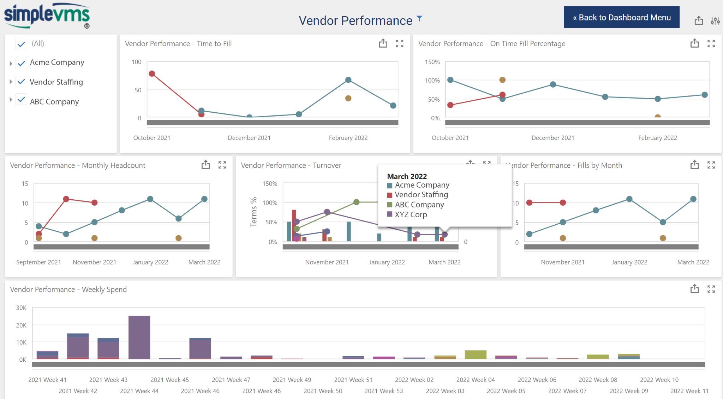
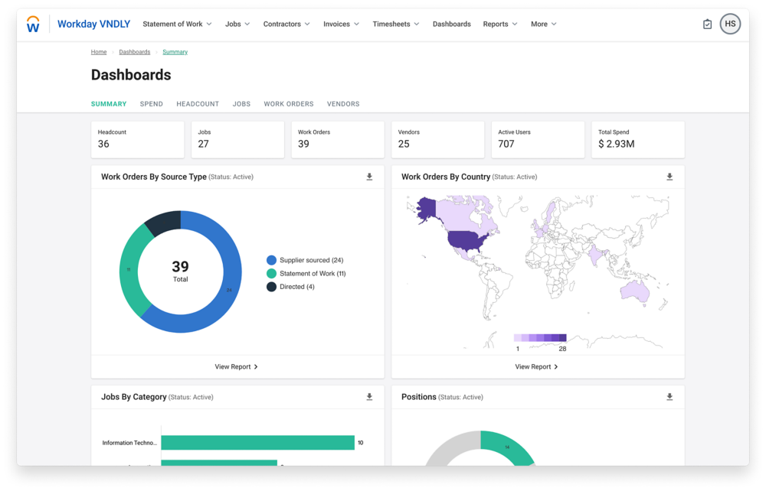
Dashboard Customization
Overview: Both Simply VMS and VNDLY offer extensive dashboard customization options, enabling users to tailor their views and data presentation to suit specific organizational needs. This flexibility in dashboard customization allows companies to monitor key metrics, visualize real-time data, and make informed decisions based on actionable insights. Indeed Flex, by contrast, provides essential shift-focused metrics designed for quick, tactical decision-making, primarily supporting gig economy and high-turnover industries.

Slide 36
Dashboard Customization: Simply VMS
Dashboard Flexibility: Simply VMS provides robust dashboard customization features, allowing users to create numerous reports and folders for vendor performance, compliance tracking, labor costs, and workforce efficiency. Users can tailor dashboards to display only the most relevant information for their role, which can improve productivity by reducing unnecessary data.
Real-Time Monitoring: Simply VMS’s dashboards support real-time updates, ensuring that users have access to the latest information. This is critical for making time-sensitive decisions and managing large teams or complex projects effectively.
Ease of Navigation: The Simply VMS interface prioritizes functionality and ease of use, with customizable dashboards that allow users to organize data in a clear and structured manner. Navigation is streamlined to ensure that essential functions, such as job order management and workforce tracking, are easily accessible.
Best Practice: By enabling users to control dashboard content and layout, Simply VMS ensures that the platform remains adaptable to different business needs. This customization also aids in compliance management and cost control, which are essential for organizations managing large, dispersed workforces. (Simply VMS Dashboard Customization and Features , Simply VMS Integrations)

Slide 37
Dashboard Customization: Vndly
Advanced Customization with Visual Appeal: VNDLY offers highly dynamic dashboards with advanced visualization tools. Users can create custom dashboards that are visually engaging, with real-time charts, graphs, and widgets that display workforce data, budget allocations, and compliance metrics.
Integration with Workday: VNDLY’s integration with Workday HCM enables seamless synchronization of data across the workforce management ecosystem. This integration provides a holistic view of both permanent and contingent labor, with dashboards that combine data from multiple sources for unified insights.
Real-Time Analytics and Predictive Insights: VNDLY’s dashboards go beyond basic reporting by offering predictive analytics. Users can configure their dashboards to display key metrics, such as workforce utilization and turnover predictions, which help with strategic planning.
Ease of Navigation and User Engagement: VNDLY’s dashboard customization is geared toward large enterprises with complex workforce requirements. The interface is intuitive, allowing managers to quickly find critical data, analyze trends, and drill down into specific areas of interest.
Best Practice: VNDLY’s dashboards are designed to support strategic decision-making by incorporating real-time and predictive analytics. This allows organizations to plan proactively and manage their workforce more effectively, leveraging VNDLY’s AI-driven insights to anticipate needs and optimize resources. (VNDLY Overview on Workday, Workday VNDLY Blog on AI and Integration)

Slide 38
Reporting Features Simply VMS, VNDLY, and Indeed Flex

Slide 39
Reporting Features: Simply VMS
SimpleVMS offers a robust suite of reporting features tailored for strategic workforce management. With over 100 standard reports and the ability to create customized reports, organizations can gain deep insights into various aspects of their contingent workforce. GetApp
Key Reporting Features:
Comprehensive Metrics: Access detailed data on workforce utilization, performance metrics, and labor costs, enabling informed decision-making. GetApp
Customizable Reports: Tailor reports to align with specific organizational goals, ensuring relevance and clarity in the information presented. Simple VMS Help
Real-Time Analytics: Utilize advanced AI-enabled reporting and analytics modules to identify and capitalize on labor market inefficiencies. Simple VMS
Enhanced Communication: Facilitate web-based interactions between your organization and staffing vendors, streamlining communication and data sharing. Simple VMS
These features collectively support strategic planning by providing actionable insights into workforce dynamics, performance trends, and cost optimization opportunities.

Slide 40
Reporting Features: Vndly
Workday VNDLY offers a comprehensive suite of reporting features designed to enhance decision-making and optimize workforce management. Key reporting capabilities include:
Extensive Pre-Built Reports: Access over 100 standard reports covering various aspects of contingent workforce management, such as headcount, roles, spend, and location. Workday
Custom Reporting Functionality: Create tailored reports to meet specific organizational needs, enabling deeper insights into workforce dynamics and performance metrics. Workday
Interactive Dashboards: Utilize data visualization tools to effectively evaluate programs, with the ability to apply filters for focused analysis. Workday
Real-Time Analytics: Leverage up-to-date data to inform strategic decisions, ensuring timely responses to workforce trends and challenges.

Slide 41
Reporting Features: Indeed Flex
Indeed Flex offers a suite of reporting features designed to enhance workforce management through data-driven insights. Key functionalities include:
Shift Reporting: Access detailed records of worker start and end times, along with specifics of the shifts undertaken, regardless of role or industry. Indeed Flex
Performance Metrics: Monitor operational statistics in real-time, both site-specific and company-wide. Metrics encompass shift fulfillment rates, expenditure, worker ratios, and quality ratings, facilitating informed decision-making. Indeed Flex
Financial Reporting: Consolidate invoicing across multiple sites and agencies within a customizable platform. Efficiently manage all bookings and extract detailed financial data for each venue, streamlining financial oversight. Indeed Flex

Slide 42
Differentiators & Selling Points Simply VMS , Vndly & Indeed Flex

Slide 43
Differentiators & Selling Points - Simply VMS & Vndly
Simply VMS
Key Differentiators:
User-Friendly Interface: Designed for ease of use, facilitating quick adoption without extensive training.
Customizable Reporting: Offers tailored reporting features to align with specific organizational needs.
Cost-Effective Solution: Provides a budget-friendly option for businesses seeking essential VMS functionalities.
Integration with MSP:
Simply VMS can function as a standalone solution or integrate with Managed Service Providers (MSPs), offering flexibility based on organizational requirements.
VNDLY
Key Differentiators:
Cloud-Native Platform: Built from the ground up as a cloud-based solution, ensuring scalability and seamless updates.
Comprehensive Workforce Management: Manages the entire lifecycle of non-employee engagements, including contingent workforce, statement of work (SOW), and independent contractors.
Robust Integration Capabilities: Integrates with existing HR, procurement, and finance systems to streamline data flow and enhance decision-making.
Integration with MSP:
VNDLY is designed to work collaboratively with MSPs, providing them with the tools and data needed to manage contingent labor programs effectively. Workday

Slide 44
Differentiators & Selling Points - Indeed Flex
Indeed Flex
Key Differentiators:
Shift-Based Staffing Focus: Specializes in filling short-term, shift-based roles, catering to industries with fluctuating staffing needs.
On-Demand Talent Pool: Provides access to a large pool of pre-vetted workers available for immediate placement.
Mobile Accessibility: Offers a user-friendly mobile app for both employers and workers, facilitating quick job postings and applications.
Integration with MSP:
Indeed Flex primarily operates as a standalone platform, focusing on direct connections between employers and temporary workers. It does not emphasize integration with MSPs.
Summary
Simply VMS offers a user-friendly and cost-effective solution with customizable reporting, suitable for organizations seeking flexibility in integrating with MSPs.
VNDLY provides a comprehensive, cloud-native platform with robust integration capabilities, designed to collaborate effectively with MSPs for managing the entire contingent workforce lifecycle.
Indeed Flex focuses on shift-based staffing through an on-demand talent pool and mobile accessibility, operating primarily as a standalone platform without significant MSP integration.

Slide 45
Approach to Partnerships and Vendor Recommendations Simply VMS , Vndly & Indeed Flex

Slide 46
Approach to Partnerships and Vendor Recommendations
Simply VMS
Partnership Approach: Simply VMS emphasizes collaboration with staffing agencies and clients, offering a Vendor Management System (VMS) tailored to their specific needs. Simple VMS
Vendor Recommendations: While Simply VMS provides a platform for managing vendor relationships, it does not explicitly state whether it recommends specific vendors or requires clients to bring their own.
2. VNDLY
Partnership Approach: VNDLY, a Workday company, collaborates closely with Managed Service Providers (MSPs) to deliver comprehensive contingent workforce solutions. Workday
Vendor Recommendations: VNDLY's platform is designed to integrate with existing vendor networks managed by MSPs, suggesting that clients typically bring their own list of vendors.

Slide 47
Approach to Partnerships and Vendor Recommendations
Summary:
Simply VMS offers a flexible VMS platform, with no explicit stance on vendor recommendations.
VNDLY integrates with MSPs and existing vendor networks, indicating that clients typically bring their own vendors.
Indeed Flex provides direct access to temporary workers, removing the necessity for external vendor lists or recommendations.

Slide 48
Billing and Time Management Across Platforms Simply VMS , Vndly & Indeed Flex

Slide 49
Billing and Time Management Across Platforms
1. Simply VMS
Time Management: Simply VMS offers integrated timekeeping solutions, including web-based time entry, physical time clocks, system imports via open API, and telephonic time tracking. These tools facilitate accurate time tracking for contingent workers. Simple VMS
Billing: The platform consolidates approved timesheets and expenses into a single invoice, streamlining the billing process for clients. Simple VMS
2. VNDLY
Time Management: VNDLY provides time and expense tracking features, allowing contingent workers to submit timesheets and expenses directly through the system. Oklahoma Government
Billing: The system automates invoicing by generating invoices from approved time and expense entries, which are then submitted for payment processing. Oklahoma Government

Slide 50
Billing and Time Management Across Platforms
3. Indeed Flex
Time Management: Indeed Flex enables workers to clock in and out via a mobile app, ensuring accurate time tracking for each shift.
Billing: The platform consolidates invoicing across multiple sites and agencies within a customizable system, allowing efficient management of all bookings and extraction of detailed financial data for each venue.
Summary:
Simply VMS and VNDLY offer integrated time tracking and automated billing within their systems, streamlining workforce management processes.
Indeed Flex provides mobile-based time tracking and customizable invoicing, catering to businesses with dynamic staffing needs.

Slide 51
Implementation Timelines for Simply VMS, VNDLY

Slide 52
Implementation Timelines for Simply VMS, VNDLY
1. Simply VMS
Implementation Timeline: Typically, Simply VMS can be implemented within four weeks. This timeline may be extended or phased geographically if necessary. The process involves minimal effort from the client's side, with the Simply VMS team handling the majority of the setup tasks. Simple VMS
2. VNDLY
Implementation Timeline: VNDLY's implementation timeline varies based on the complexity and scope of the deployment. While specific durations are not publicly detailed, VNDLY emphasizes a rapid deployment methodology that can enable a Vendor Management System (VMS) program in less than half the time of a traditional implementation. This approach focuses on quickly standing up the VMS by adhering to key principles and leveraging the experience of VNDLY's subject matter experts. Staffing Industry

Slide 53
Implementation Timelines for Simply VMS, VNDLY
3. Indeed Flex
Implementation Timeline: Indeed Flex does not publicly specify a standard implementation timeline. However, as a platform designed for on-demand staffing, it is structured to facilitate swift onboarding and deployment, allowing businesses to quickly connect with a pool of pre-vetted temporary workers.
Summary:
Simply VMS offers a relatively quick implementation process, typically around four weeks, with flexibility for phased rollouts.
VNDLY focuses on rapid deployment methodologies, potentially reducing implementation time to less than half that of traditional VMS implementations, though exact timelines depend on project specifics.
Indeed Flex is designed for rapid onboarding, enabling businesses to quickly access temporary staffing solutions, though specific implementation timelines are not detailed.

Slide 54
Pricing Structures for Simply VMS, VNDLY

Slide 55
Pricing Structures for Simply VMS, VNDLY
1. Simply VMS
Pricing Model: Simply VMS operates on a vendor-funded model, meaning there is no cost to clients. Vendors pay a small percentage to utilize the system. G2
Additional Costs: There are no charges for implementations, customizations, integrations, support, or time clocks. G2
2. VNDLY
Pricing Model: VNDLY's pricing is not publicly disclosed and is typically customized based on the client's specific needs and the scope of services required. Capterra
Additional Costs: Details regarding additional costs such as implementation, customization, or support are not specified publicly and would be determined during contract negotiations.

Slide 56
Pricing Structures for Simply VMS, VNDLY
3. Indeed Flex
Pricing Model: Indeed Flex charges a markup on the worker's hourly rate, which covers the platform's services, including recruitment, vetting, and management of temporary staff.
Additional Costs: There are no setup fees or subscription costs; clients pay only for the hours worked by the temporary staff provided through the platform.
Summary:
Simply VMS offers a cost-effective solution with no direct charges to clients, as vendors bear the system's costs.
VNDLY provides customized pricing tailored to each client's requirements, with specifics determined during the sales process.
Indeed Flex utilizes a straightforward markup on hourly rates, with no additional fees, making it a transparent option for temporary staffing needs.

Slide 57
Average Client Size

Slide 58
Average Client Size
VNDLY, a cloud-based vendor management system, primarily serves large enterprises. As of 2024, approximately 27 of its clients have over 10,000 employees, 19 have between 1,000 and 4,999 employees, and 18 have between 5,000 and 9,999 employees.
6sense
This distribution indicates that VNDLY's average client size is substantial, with a significant portion of its clientele comprising large organizations.
In contrast, SimpleVMS caters to a diverse range of clients, including small, mid-sized, and large enterprises. The platform is designed to streamline vendor management processes across various industries and company sizes.
Simple VMS
Specific numerical data regarding the average client size of SimpleVMS is not publicly available. However, case studies suggest that SimpleVMS effectively supports clients with varying workforce scales, such as a manufacturing client managing between 150 to 350 temporary workers across multiple sites.
Simple VMS
In summary, VNDLY predominantly serves large enterprises, while SimpleVMS accommodates a broad spectrum of company sizes, tailoring its services to meet diverse client needs.

Slide 59
What are their standard Contract terms?

Slide 60
What are their standard Contract terms?
1. Simply VMS
Service Agreement: Simply VMS provides a web-based Vendor Management System (VMS) that enables clients to manage their contingent workforce. The platform is user-friendly and designed to consolidate vendor pools, ensure HR policy compliance, reduce costs, and accelerate time-to-hire. Simple VMS
Pricing Model: Simply VMS operates on a vendor-funded model, meaning there is no cost to clients. Vendors pay a small percentage to utilize the system. Simple VMS
Implementation and Support: There are no charges for implementations, customizations, integrations, support, or time clocks. Simple VMS
Liability and Indemnification: Simply VMS's Terms of Service include provisions that limit their liability concerning the use of their services. They disclaim warranties and limit liability for special, incidental, or consequential damages. Simple VMS

Slide 61
What are their standard Contract terms?
VNDLY
Service Agreement: VNDLY, a Workday company, offers a cloud-native platform designed to centralize, standardize, and optimize contingent workforce programs. The platform supports the entire non-employee engagement lifecycle, including talent acquisition, training, payment, and offboarding. Workday
Pricing Model: VNDLY's pricing is not publicly disclosed and is typically customized based on the client's specific needs and the scope of services required. Spend Matters
Implementation and Support: VNDLY emphasizes a rapid deployment methodology that can enable a Vendor Management System (VMS) program in less than half the time of a traditional implementation. This approach focuses on quickly standing up the VMS by adhering to key principles and leveraging the experience of VNDLY's subject matter experts. Spend Matters
Liability and Indemnification: Specific details regarding liability and indemnification are not publicly disclosed. These terms would typically be outlined in the Master Service Agreement (MSA) during contract negotiations.

Slide 62
What are their standard Contract terms?
Summary:
Simply VMS offers a cost-effective solution with no direct charges to clients, as vendors bear the system's costs. Their Terms of Service include provisions that limit their liability concerning the use of their services.
VNDLY provides customized pricing tailored to each client's requirements, with specifics determined during the sales process. Details regarding liability and indemnification are typically outlined in the Master Service Agreement (MSA) during contract negotiations.

Slide 63
What are their standard Contract terms?
Workday VNDLY:
As part of Workday's suite of products, VNDLY operates under the company's Universal Main Subscription Agreement (UMSA). This agreement encompasses essential foundational terms applicable to all Workday offerings. The UMSA includes provisions related to data processing, security, acceptable use, and service level availability. Specific terms, such as subscription duration, pricing, and service specifics, are detailed in individual order forms or agreements. Clients are encouraged to review these documents thoroughly to understand the commitments and obligations involved.
Workday
SimpleVMS:
SimpleVMS distinguishes itself by not requiring long-term contracts. Clients can utilize the platform with the flexibility to discontinue services with a 30-day notice if it doesn't meet their needs. This approach allows potential users to pilot the system at a specific site without financial commitment, ensuring it aligns with their operational requirements before broader implementation.
Simple VMS
In summary, Workday VNDLY operates under comprehensive subscription agreements with specified terms, while SimpleVMS offers a more flexible, commitment-free model, enabling clients to assess the platform's suitability without long-term obligations.

Slide 64
What are their standard Contract terms?

Slide 65
What are their standard Contract terms?
Simply VMS
Service Agreement: Simply VMS provides a web-based Vendor Management System (VMS) that enables clients to manage their contingent workforce. The platform is user-friendly and designed to consolidate vendor pools, ensure HR policy compliance, reduce costs, and accelerate time-to-hire. Simple VMS
Pricing Model: Simply VMS operates on a vendor-funded model, meaning there is no cost to clients. Vendors pay a small percentage to utilize the system. Simple VMS
Implementation and Support: There are no charges for implementations, customizations, integrations, support, or time clocks. Simple VMS
Liability and Indemnification: Simply VMS Terms of Service include provisions that limit their liability concerning the use of their services. They disclaim warranties and limit liability for special, incidental, or consequential damages. Simple VMS

Slide 66
What are their standard Contract terms?
VNDLY
Service Agreement: VNDLY, a Workday company, offers a cloud-native platform designed to centralize, standardize, and optimize contingent workforce programs. The platform supports the entire non-employee engagement lifecycle, including talent acquisition, training, payment, and offboarding. Workday
Pricing Model: VNDLY's pricing is not publicly disclosed and is typically customized based on the client's specific needs and the scope of services required. Spend Matters
Implementation and Support: VNDLY emphasizes a rapid deployment methodology that can enable a Vendor Management System (VMS) program in less than half the time of a traditional implementation. This approach focuses on quickly standing up the VMS by adhering to key principles and leveraging the experience of VNDLY's subject matter experts. Spend Matters
Liability and Indemnification: Specific details regarding liability and indemnification are not publicly disclosed. These terms would typically be outlined in the Master Service Agreement (MSA) during contract negotiations.

Slide 67
Questions?

